Slide 1

Notes:
1st slide (Mandatory)

Slide 2

Maze Solving
Introduction
Consider the maze to be a black and white image, with black pixels representing walls, and white pixels representing a path. Two white pixels are special, one being the entry to the maze and another exit.
Given such a maze, we want to find a path from entry to the exit.
Modelling the Maze
0 -> Road
1 -> Wall
2 -> Maze entry
3 -> Maze exit
4 -> Cell part of the path from entry to exit
Topic/Course

Slide 3
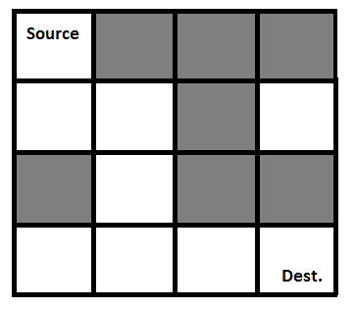
Gray blocks are dead ends (value = 0).
binary matrix representation of the above maze.
{ 1, 0, 0, 0}
{1, 1, 0, 1}
{0, 1, 0, 0}
{1, 1, 1, 1}

Slide 4
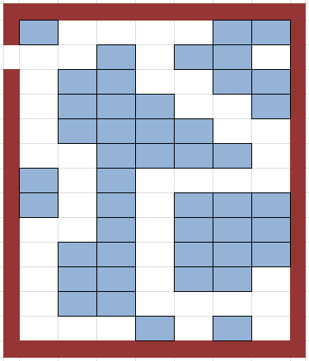

Slide 5
public class RatMaze {
final int N = 4;
void printSolution(int sol[][]){
for (int i = 0; i < N; i++) {
for (int j = 0; j < N; j++)
System.out.print(" " + sol[i][j] + " ");
System.out.println();
}}
boolean isSafe(int maze[][], int x, int y){
return (x >= 0 && x < N && y >= 0 && y < N && maze[x][y] == 1);
}
{
int sol[][] = { { 0, 0, 0, 0 },
{ 0, 0, 0, 0 },
{ 0, 0, 0, 0 },
{ 0, 0, 0, 0 } };
if (solveMazeUtil(maze, 0, 0, sol) == false) {
System.out.print("Solution doesn't exist");
return false;
}
printSolution(sol);
return true;
}
boolean solveMazeUtil(int maze[][], int x, int y,int sol[][]){
if (x == N - 1 && y == N - 1) {
sol[x][y] = 1;
return true;
}
if (isSafe(maze, x, y) == true) {
sol[x][y] = 1;
if (solveMazeUtil(maze, x + 1, y, sol))
return true;
if (solveMazeUtil(maze, x, y + 1, sol))
return true;

Slide 6
sol[x][y] = 0; return false; } return false; } public static void main(String args[]){ RatMaze rat = new RatMaze(); int maze[][] = { { 1, 0, 0, 0 }, { 1, 1, 0, 1 }, { 0, 1, 0, 0 }, { 1, 1, 1, 1 } }; rat.solveMaze(maze); } }
Output: 1 0 0 0 1 1 0 0 0 1 0 0 0 1 1 1
maze[][]={ {1, 1, 1, 1, 1}, {0, 0, 1, 0, 1}, {1, 1, 1, 1, 0}, {1, 0, 0, 0, 1}, {1, 1, 1, 1, 1} };

Slide 7

THANK YOU

